Slide 1

RESTAURANT ANALYSIS OF SWIGGY
Presented by Sruthi Vijay(BADM-WD-E-B1)

Slide 2
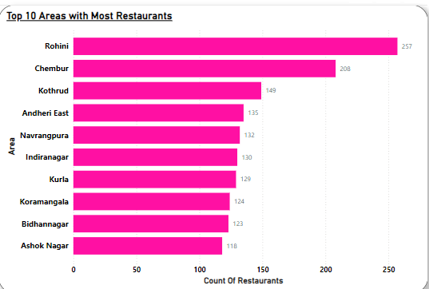
Task 1: Top 10 Areas with Most Restaurant
Analysis
High-Density Zones: Rohini and Chembur lead with the highest restaurant counts, indicating these areas as key customer hotspots with intense competition.
Urban and Commercial Areas: Many of these high-density areas are urban and commercially active, with a large target audience of potential customers.
Recommendations
Targeted Promotions
Optimize Delivery Logistics
New Market Potential

Slide 3
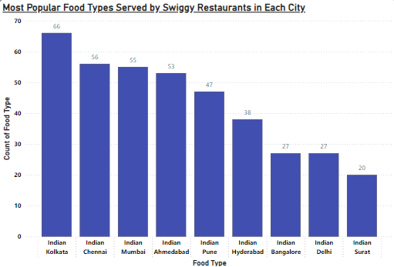
Task 2: Most Popular Food Types Served by Swiggy Restaurants in Each City
Analysis
High Demand for Indian Cuisine: Indian cuisine is widely popular, consistently ranking as the top food type in all listed cities.
Regional Preferences: The high counts in cities like Kolkata and Chennai indicate a strong preference for Indian cuisine, suggesting Swiggy’s current offerings align well with local tastes.
Recommendations
Localized Marketing
Cuisine Diversification
Partnership Opportunities

Slide 4
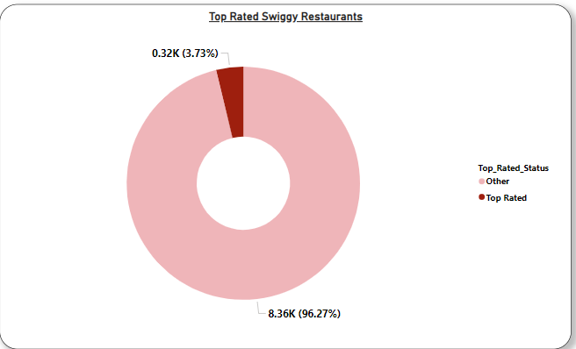
Task 3: Top Rated Swiggy Restaurants (In Percentage)
Top Rated Restaurants:
Top Rated (Average Rating > 4.5): 3.73% (0.32K restaurants)
Other: 96.27% (8.36K restaurants)
Key Insight
Only a small fraction (3.73%) of Swiggy restaurants have achieved a top rating above 4.5, while the vast majority fall below this threshold.
Analysis
Limited High-Rated Options: The low percentage of top-rated restaurants indicates an opportunity for quality improvement.
Customer Perception: A higher proportion of top-rated options could improve customer perception, potentially increasing user satisfaction and loyalty.
Recommendations
Quality Improvement Initiatives
Incentives for High Ratings
Customer Feedback Collection
Highlight Top Rated Restaurants

Slide 5
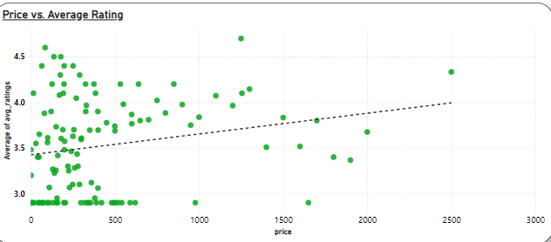
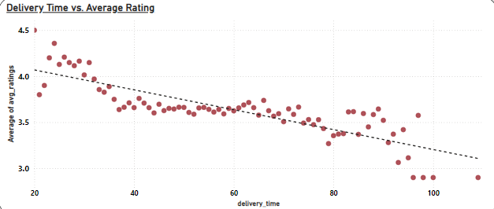
Task 4: Correlation of Factors Affecting Average Rating
Key Findings
Price vs. Average Rating
Observation: There is a slight positive correlation between price and average ratings.
Analysis: As the price increases, average ratings tend to increase mildly. This suggests that customers may associate higher prices with better quality or premium service.
Delivery Time vs. Average Rating
Observation: There is a strong negative correlation between delivery time and average ratings.
Analysis: Longer delivery times tend to result in lower average ratings. This highlights the importance of timely service in maintaining customer satisfaction.

Slide 6
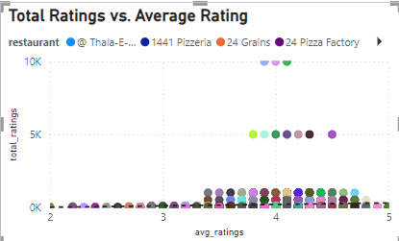
Total Ratings vs. Average Rating
Observation: A wide range of average ratings is observed regardless of the number of total ratings.
Analysis: Popular restaurants (with high total ratings) generally have high average ratings. However, there are instances of restaurants with many ratings but only moderate average scores, indicating variability in customer experiences.
Recommendations
Optimize Delivery Time
Enhance Perceived Value through Pricing Strategy
Leverage Customer Feedback for Popular and High-Rating Items
Tailor Strategies by Location and Cuisine Type
Improve Customer Experience through Consistent Quality and Timely Service

Slide 7
Task 5: Correlation Between Restaurant Price and Average Rating
Price vs. Average Rating
Observation: A mild positive correlation exists between price and average ratings.
Analysis: Higher-priced items tend to receive slightly better ratings, likely due to perceived higher quality or premium experience.
Key Insight:
Customers may equate higher prices with better quality, influencing their rating behavior.
Recommendation:
Emphasize the quality of premium-priced menu items in marketing.
Offer clear value propositions for higher-priced items to justify their cost and boost ratings.

Slide 8
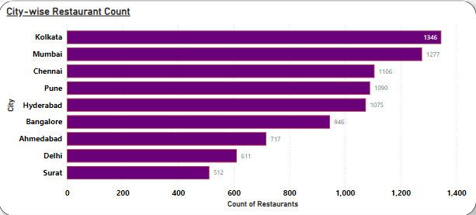
Task 6: City-wise Restaurant Count
Findings
Top 3 Cities by Restaurant Count:
Kolkata leads with the highest number of restaurants (1,346).
Mumbai follows closely with 1,277 restaurants.
Chennai ranks third with 1,106 restaurants.
Mid-range Cities:
Pune and Hyderabad have a similar restaurant count (around 1,075-1,090), indicating strong regional presence.
Bangalore has 946 restaurants, slightly behind Hyderabad.
Lowest Restaurant Counts:
Surat and Delhi have the fewest restaurants, with 512 and 611 respectively, suggesting potential growth opportunities in these areas.

Slide 9
Key Insight
Major metro cities (Kolkata, Mumbai, Chennai) have the highest number of restaurants, indicating a competitive landscape.
Smaller cities like Surat show lower counts, presenting opportunities for new market entry and expansion.
Recommendations
Expand in Emerging Markets:
Focus on increasing presence in underrepresented cities like Surat and Delhi to capture untapped demand.
Strengthen Competitive Edge in Top Cities:
Enhance service offerings and marketing in cities like Kolkata and Mumbai to maintain a strong market position.

Slide 10
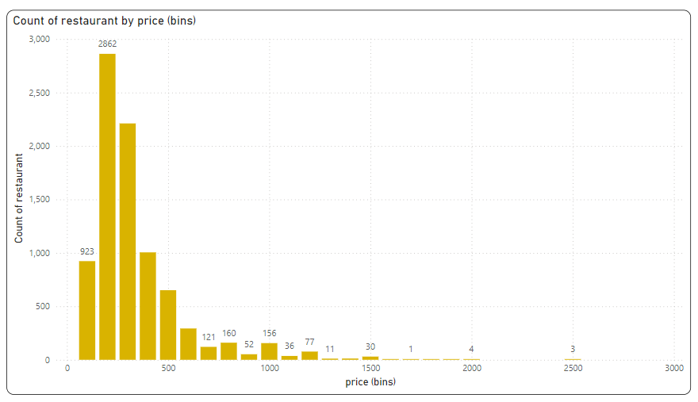
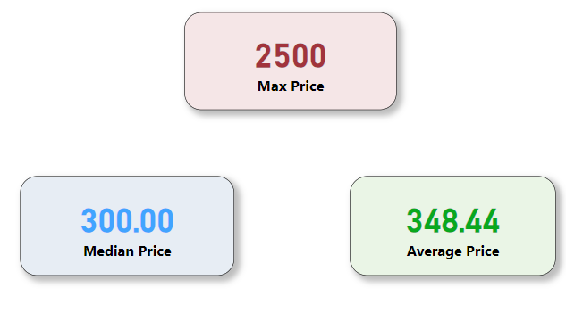
Task 7: Price Analysis
Findings
Price Distribution:
Majority of restaurants (over 2,800) fall into the lower price bin (0-500), indicating a strong preference for affordable pricing.
There is a sharp decline in the count of restaurants as the price range increases beyond 500, with very few restaurants pricing above 1,500.
Price Statistics:
Maximum Price: ₹2,500
Average Price: ₹348.44
Median Price: ₹300.00
Skewed Distribution:
The data shows a right-skewed distribution, with most restaurants pricing around or below the median value (₹300), and only a small number offering high-priced items.

Slide 11
Key Insight
The restaurant market is dominated by lower-priced offerings, suggesting that affordability is a key factor in attracting customers.
Higher-priced restaurants are limited, indicating potential for premium segment growth in the market.
Recommendations
Capitalize on Affordability
Explore Premium Offerings

Slide 12
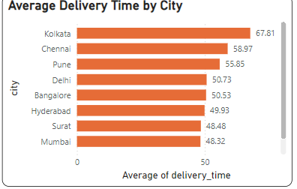
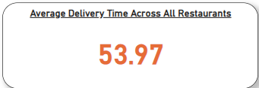
Task 8: Delivery Time Analysis
Findings
Average Delivery Time Across All Restaurants: 53.97 minutes
Top Cities with Longest Delivery Times:
Kolkata: 67.81 minutes
Chennai: 58.97 minutes
Pune: 55.85 minutes
Delivery Time Distribution
0-50 minutes: Majority of restaurants (5.7K) fall in this range.
50-100 minutes: 2.8K restaurants, indicating longer delivery times for a significant number.
100+ minutes: Only a few restaurants (0.1K) have excessively high delivery times.
City-Wise Average Delivery Time
Kolkata has the longest average delivery time, followed by Chennai and Pune.
Mumbai and Surat show the shortest average delivery times among the listed cities.

Slide 13
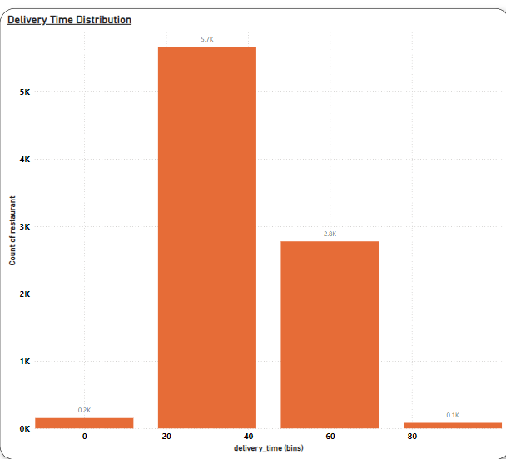
Key Insights
High Average Times in Kolkata and Chennai: The delivery times are significantly higher, impacting customer satisfaction.
Majority within Acceptable Range: A substantial number of restaurants deliver within 50 minutes, which is generally reasonable.
Outliers Above 100 Minutes: Few restaurants have extremely high delivery times, potentially due to distance, traffic, or operational inefficiencies.
Recommendations:
Targeted Optimization: Focus on optimizing delivery in cities with high average times (Kolkata, Chennai, Pune).
Process Improvements: Streamline operations for restaurants with delivery times over 100 minutes.
Geo-Specific Strategies: Introduce local incentives or alternative delivery methods (e.g., express delivery options) in cities with higher delivery times.

Slide 14
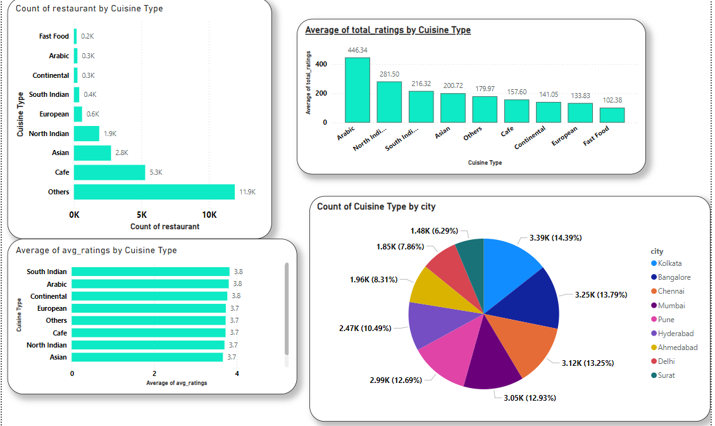
Task 9: Cuisine Analysis
Findings
Distribution Analysis
Cuisine Variety
"Others" category dominates with 11.9K restaurants (largest segment)
Cafe (5.3K) and Asian (2.8K) follow as major categories
North Indian cuisine has significant presence (1.9K restaurants)
Niche cuisines (Arabic, Continental, Fast Food) have smaller but notable presence (~0.2-0.3K each)
Rating Analysis
Customer Satisfaction
South Indian and Arabic cuisines lead with highest average ratings (3.8/5)
Most cuisines maintain consistent ratings between 3.7-3.8
Minimal variation in customer satisfaction across cuisines
Arabic cuisine shows highest total ratings (446.34), indicating high customer engagement

Slide 15
Popular Cuisines by City
Kolkata leads with 3.39K (14.39%) restaurants
Strong restaurant presence in major metros:
Bangalore: 3.25K (13.79%)
Chennai: 3.12K (13.25%)
Mumbai: 3.05K (12.93%)
Recommendations
Menu Diversification
Quality Standardization
Market Expansion
Customer Engagement
Niche Market Development

Slide 16
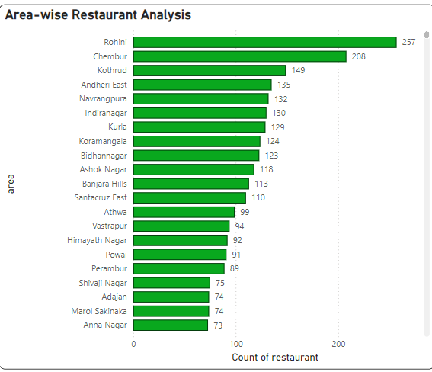
Task10: Area-wise Restaurant Analysis
Findings
Top Areas with Highest Restaurant Counts:
Rohini: 257 restaurants
Chembur: 208 restaurants
Kothrud: 149 restaurants
Mid-range Areas:
Andheri East, Navrangpura, Indiranagar, and Kurla all have around 125-135 restaurants.
Lower Restaurant Count Areas:
Areas like Marol Sakinaka and Anna Nagar have the fewest restaurants, with 73 each.
Observations
Rohini and Chembur are Highly Populated with Restaurants: These areas have the most establishments, potentially due to high demand or larger population density.
Wide Distribution Across Areas: The number of restaurants varies significantly, indicating diverse restaurant coverage across different neighborhoods.

Slide 17
Key Insights
Concentration in Key Areas: Certain areas, like Rohini and Chembur, have a dense concentration of restaurants, which may lead to high competition.
Under-Served Areas: Areas with lower counts (e.g., Marol Sakinaka and Anna Nagar) may present opportunities for growth.
Recommendations
Expansion Strategy
Competitive Analysis in High-Density Areas
Promotional Campaigns in Mid-Range Areas

Slide 18
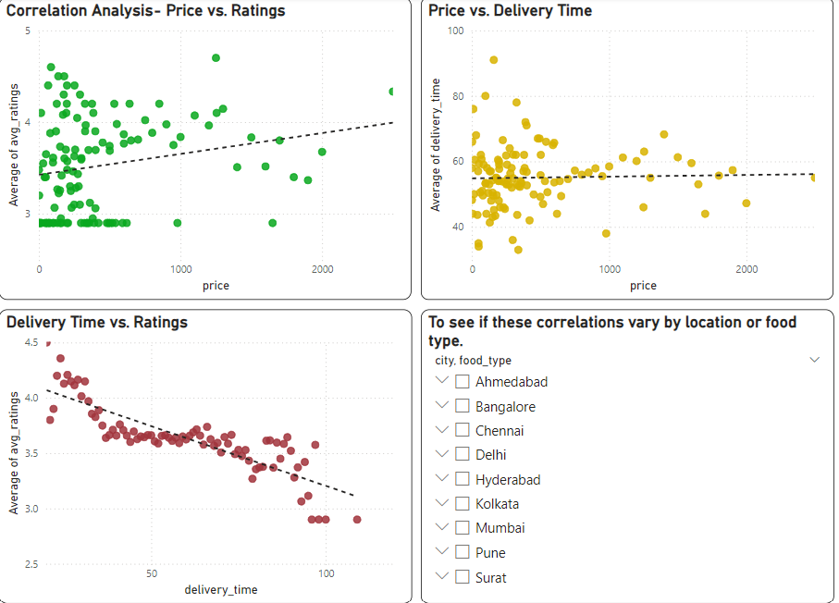
Task 11: Correlation Analysis
Findings
Price vs. Ratings: A weak positive correlation is observed. Higher-priced restaurants tend to have slightly better ratings, but the relationship is not strong.
Price vs. Delivery Time: Minimal correlation exists between price and delivery time, suggesting that higher prices do not necessarily lead to faster or slower deliveries.
Delivery Time vs. Ratings: Strong negative correlation observed. Longer delivery times are associated with lower ratings, indicating a clear preference for faster service among customers.

Slide 19
Key Insights
Customer Satisfaction and Delivery Time: Faster delivery times are crucial for higher customer ratings, emphasizing the importance of timely delivery.
Price Impact on Ratings is Minimal: While higher prices slightly correlate with better ratings, the impact is marginal, suggesting other factors (e.g., service quality, food taste) might drive ratings more.
Delivery Time Independent of Price: Price does not seem to affect delivery time, indicating that operational factors (e.g., restaurant location, logistics) may be more significant.
Recommendations
Focus on Reducing Delivery Time
Enhance Value for High-Priced Options
Conduct Further Analysis by Location

Slide 20
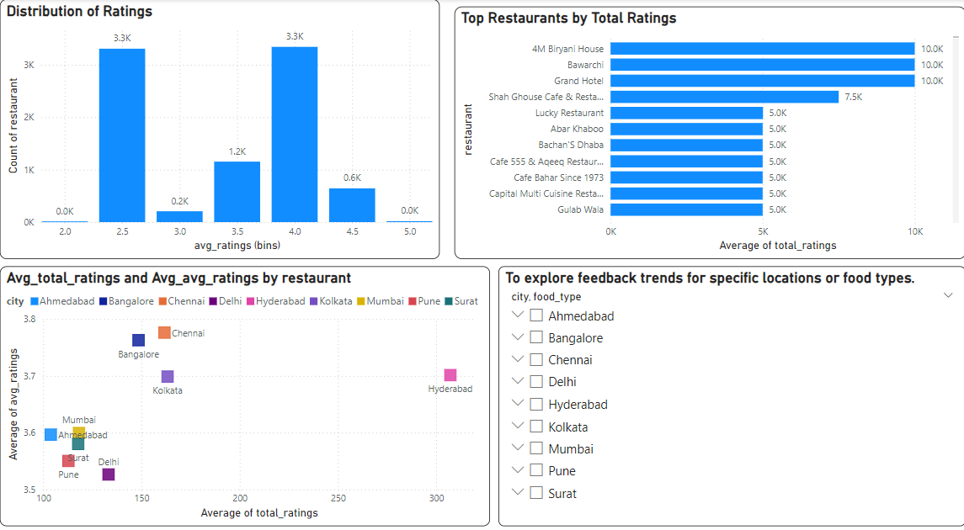
Task 12: Customer Feedback Analysis
Findings
Most ratings fall between 2.5 and 4.0.
Key Insights
2.5 - 3.0 ratings: High count (3.3K restaurants).
3.5 - 4.0 ratings: Another peak (3.3K restaurants).
Few restaurants have ratings over 4.0, indicating room for improvement.
Top Restaurants by Total Ratings
Top Performers: Restaurants with highest engagement include:
4M Biryani House, Bawarchi, and Grand Hotel with 10K total ratings each.
Observation: High engagement does not always correlate with high ratings, indicating potential quality or consistency issues.

Slide 21
Average Total Ratings vs. Average Ratings by City
Chennai and Bangalore show the highest average ratings (around 3.8).
Hyderabad shows high average total ratings but moderate average ratings (around 3.6).
Pune and Surat have lower engagement and ratings.
Key Insights
High volume of total ratings for specific restaurants suggests strong brand presence or popularity.
Variance in average ratings across cities highlights potential regional satisfaction differences.
Cities with lower ratings could have service or quality issues needing attention.
Recommendations
Improve Customer Experience in Low-Rating Areas:
Encourage High-Rated Locations to Increase Reviews
Quality Consistency

Slide 22
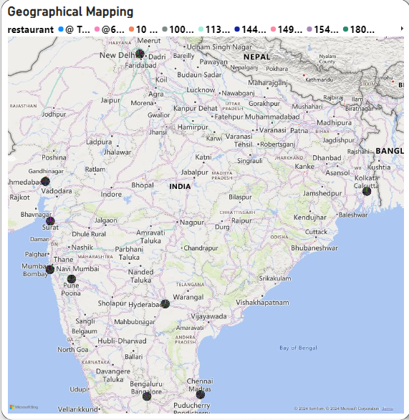
Task 13: Geographical Mapping
Map Analysis
High Restaurant Concentration in Metro Cities
Cities: Mumbai, Bangalore, Hyderabad, and Kolkata show high restaurant presence and likely higher customer engagement.
Implication: These cities are key markets with established brand recognition and active customer bases.
Regional Distribution
South and West India: Higher density of restaurant locations, indicating a stronger market presence.
East and North-East: Limited presence, mainly around Kolkata.
North and Central India: Moderate concentration around New Delhi, with sparse distribution elsewhere.
Underserved Areas
Potential Opportunities: Regions with fewer or no restaurants, particularly in Central and parts of Northern India, may represent areas for expansion.

Slide 23
Key Insights
Recommendations
-Targeted Marketing and Promotions
-Expansion Strategy
-Improve Customer Experience in Key Markets
Engagement Hotspots: High customer engagement likely in cities with dense restaurant clusters like Bangalore, Mumbai, and Hyderabad.
Market Gaps: Regions with limited or no restaurants could be strategic for expansion or marketing focus, especially in Central and Eastern India.
Customer Experience: High-engagement cities should be prioritized for enhancing customer service, menu variety, and promotional efforts.

Slide 24
Task 14: Business Recommendations
Optimize Delivery Time Strategy
Market Expansion in Underserved Areas
Cuisine Portfolio Optimization
Price-Performance Alignment
Geographic Performance Enhancement

